Slide 1
Cubic Tangent Circle

Slide 2
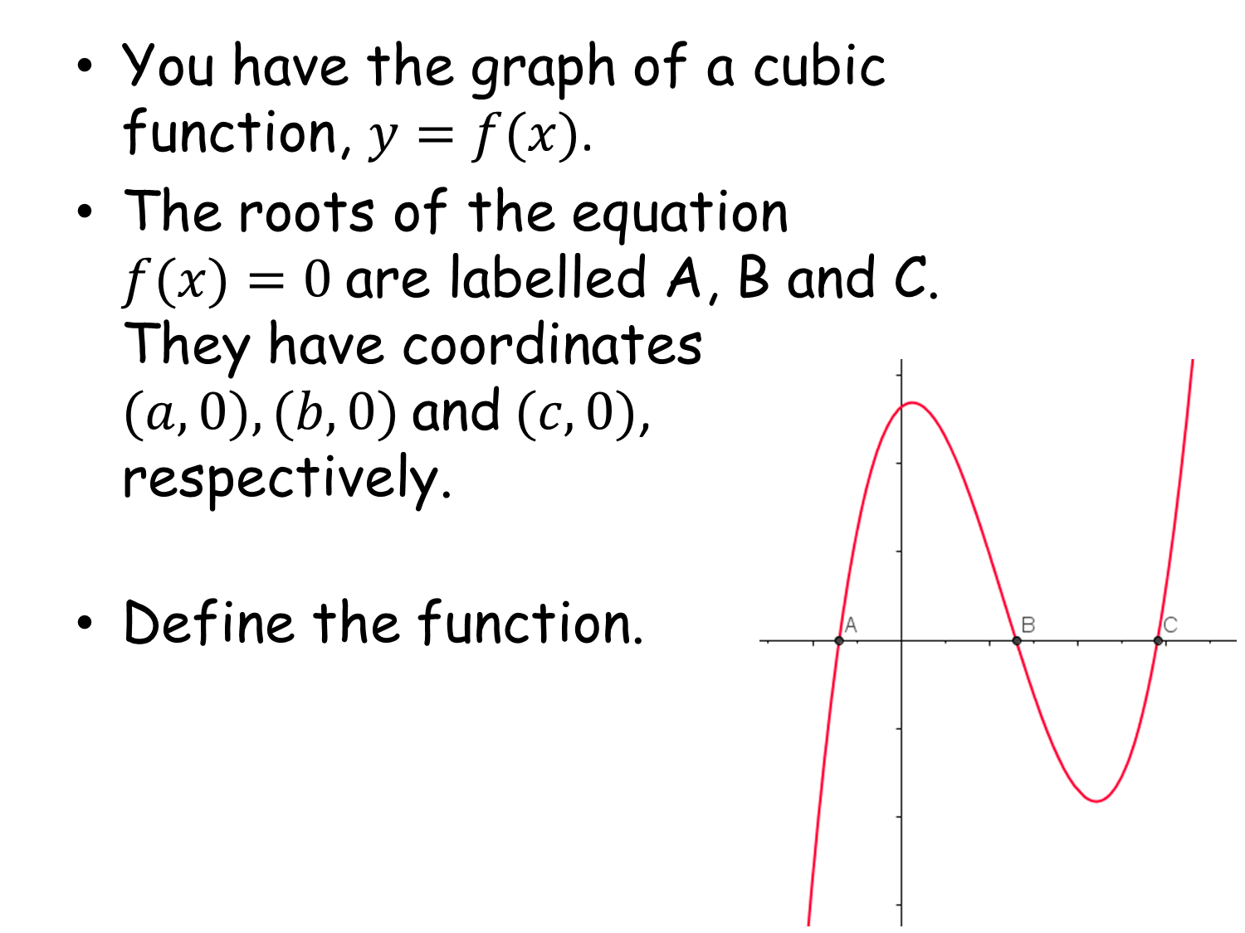
Cubic Tangent Circle

Slide 3
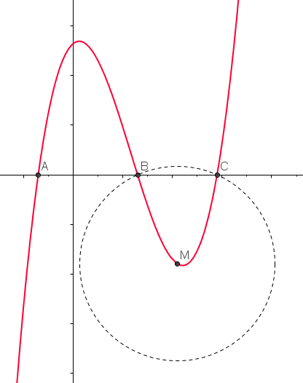
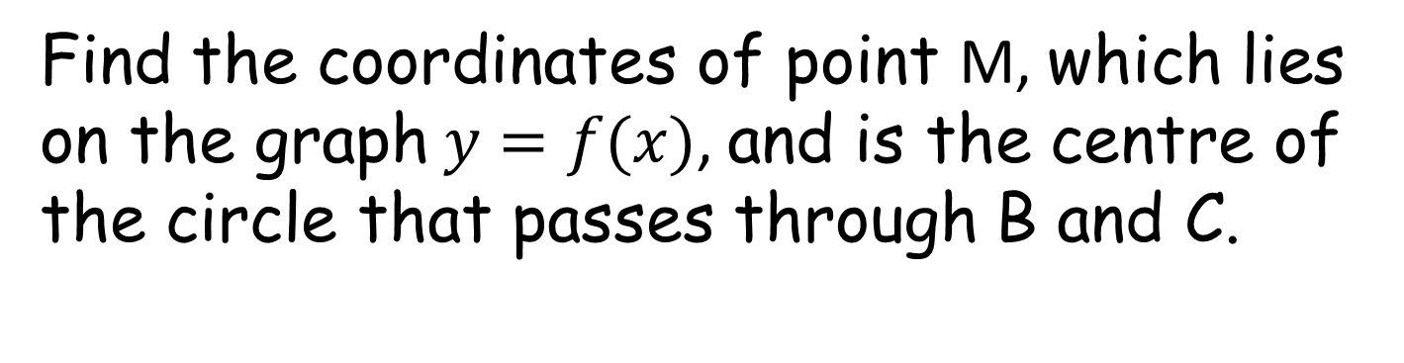
Find the coordinates of point M, which lies on the graph $y=f(x)$, and is the centre of the circle that passes through B and C.

Slide 4
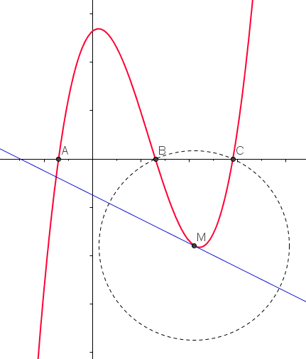

Draw a tangent to the graph at M and determine where it cuts the $x$-axis.
Use algebra to work out the equation of the tangent to check your accuracy.

Slide 5

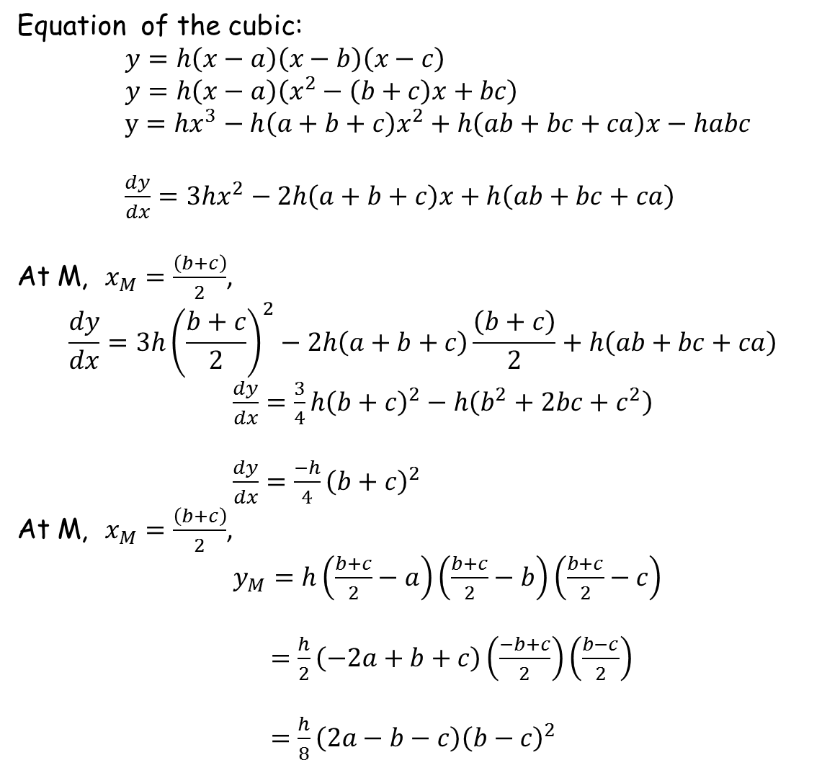

Equation of the cubic:
$y=h\left(x−a\right)\left(x−b\right)\left(x−c\right)$
$y=h\left(x−a\right)\left(x^{2}−\left(b+c\right)x+bc\right)$
$y={hx}^{3}−h\left(a+b+c\right)x^{2}+h\left(ab+bc+ca\right)x−habc$
$\frac{dy}{dx}=3hx^{2}−2h\left(a+b+c\right)x+h\left(ab+bc+ca\right)$
At M, $x_{M}=\frac{\left(b+c\right)}{2}$,
$$\frac{dy}{dx}=3h{\left(\frac{b+c}{2}\right)}^{2}−2h\left(a+b+c\right)\frac{\left(b+c\right)}{2}+h\left(ab+bc+ca\right)$$
$\frac{dy}{dx}=\frac{3}{4}{h\left(b+c\right)}^{2}−h\left(b^{2}+2bc+c^{2}\right)$
$\frac{dy}{dx}=\frac{−h}{4}{\left(b+c\right)}^{2}$
At M, $x_{M}=\frac{\left(b+c\right)}{2}$,
$y_{M}=h\left(\frac{b+c}{2}−a\right)\left(\frac{b+c}{2}−b\right)\left(\frac{b+c}{2}−c\right)$
$=\frac{h}{2}\left(−2a+b+c\right)\left(\frac{−b+c}{2}\right)\left(\frac{b−c}{2}\right)$
$=\frac{h}{8}\left(2a−b−c\right){\left(b−c\right)}^{2}$
$x$-coordinate of M
Gradient at M
$y$-coordinate of M

Slide 6
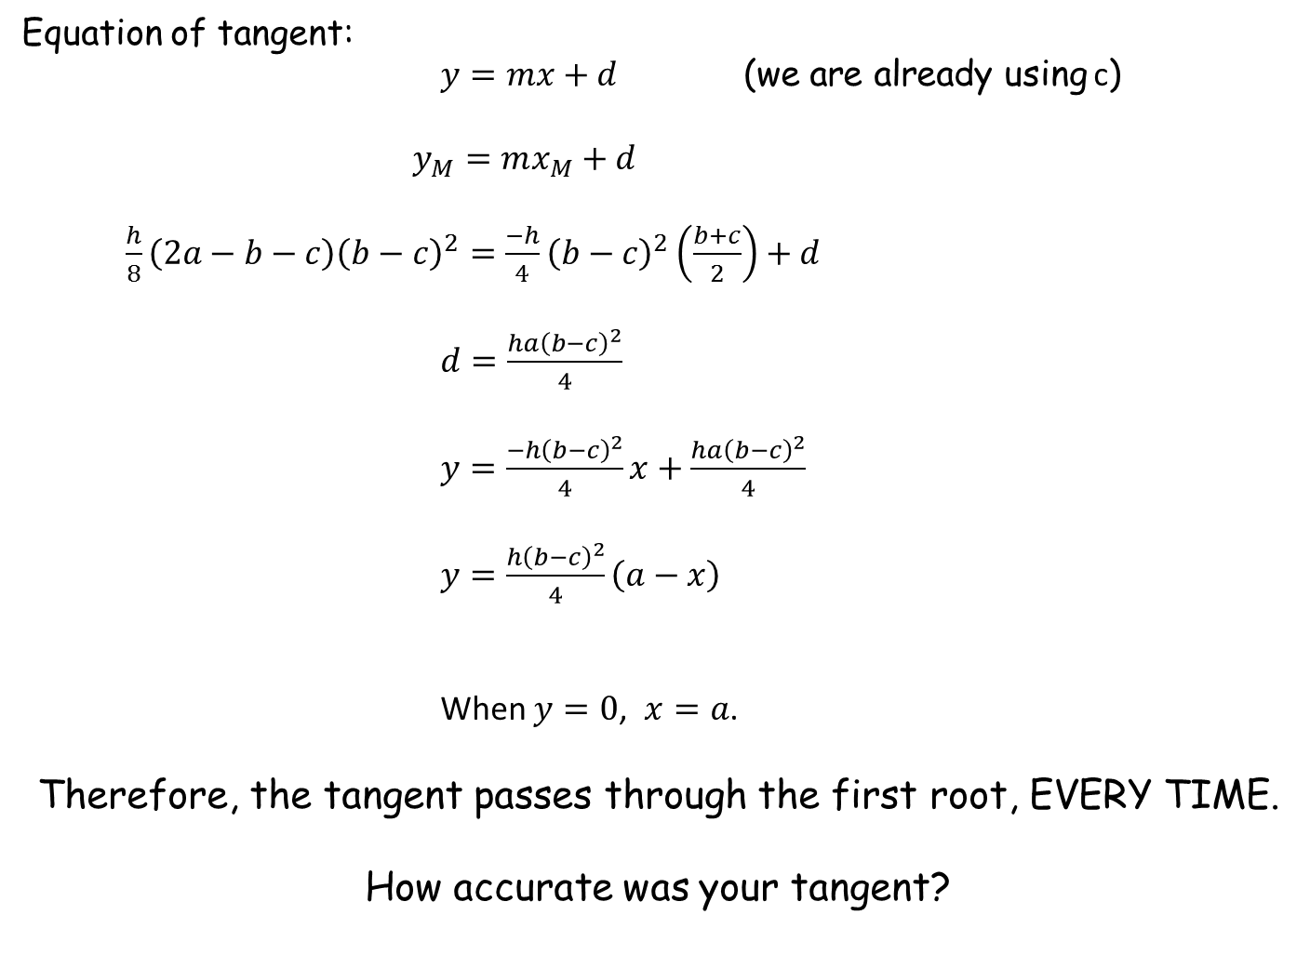
Equation of tangent:
$y=mx+d$ (we are already using c)
$y_{M}=mx_{M}+d$
$\frac{h}{8}\left(2a−b−c\right){\left(b−c\right)}^{2}=\frac{−h}{4}{\left(b−c\right)}^{2}\left(\frac{b+c}{2}\right)+d$
$d=\frac{ha{\left(b−c\right)}^{2}}{4}$
$y=\frac{−h{\left(b−c\right)}^{2}}{4}x+\frac{ha{\left(b−c\right)}^{2}}{4}$
$y=\frac{h{\left(b−c\right)}^{2}}{4}\left(a−x\right)$
When $y=0$, $x=a$.
Therefore, the tangent passes through the first root, EVERY TIME.
How accurate was your tangent?

Slide 8
Note to teacher
The same will work if they started with the first two roots, i.e. the tangent should then go through the third.
In fact, the tangent at the midpoint of any pair of roots will go through the remaining root! With thanks to Mark Richards of Lancaster Grammar Schools for Girls.

Slide 9
Resources

Slide 10
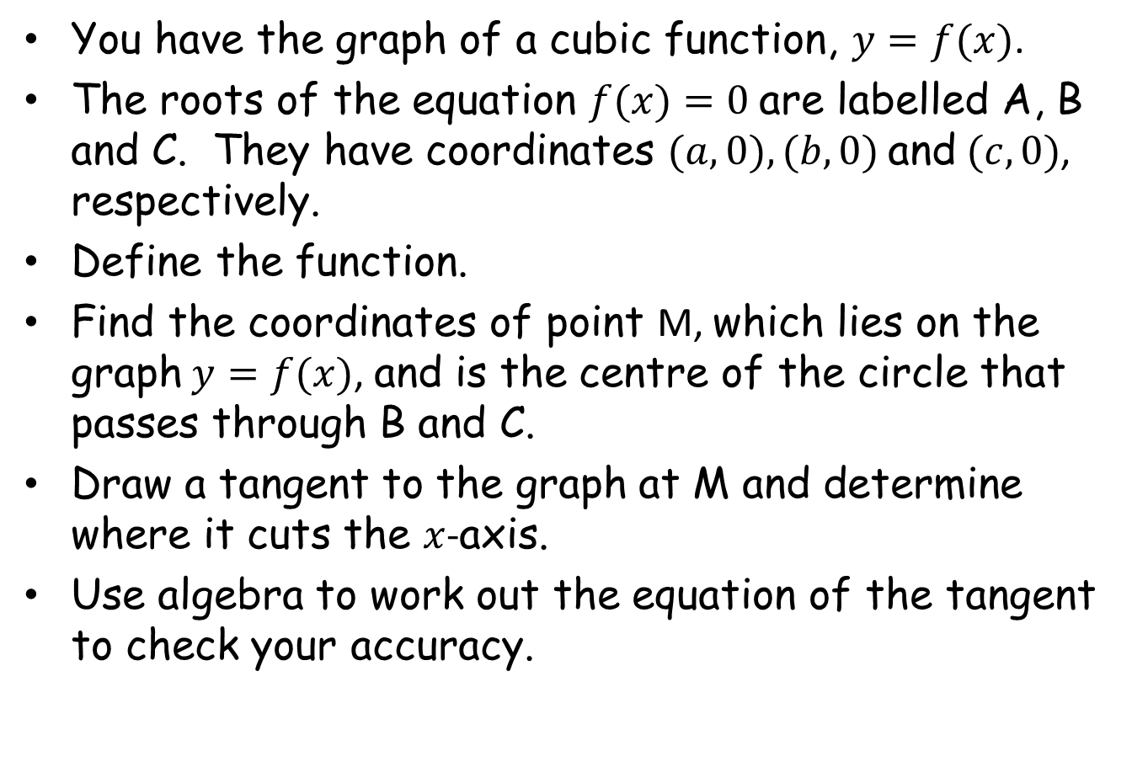
You have the graph of a cubic function, $y=f(x)$.
The roots of the equation $f(x)=0$are labelled A, B and C. They have coordinates $(a,0), (b,0)$ and $(c,0)$, respectively.
Define the function.
Find the coordinates of point M, which lies on the graph $y=f(x)$, and is the centre of the circle that passes through B and C.
Draw a tangent to the graph at M and determine where it cuts the $x$-axis.
Use algebra to work out the equation of the tangent to check your accuracy.
SIC_19
Notes:
instructions

Slide 11
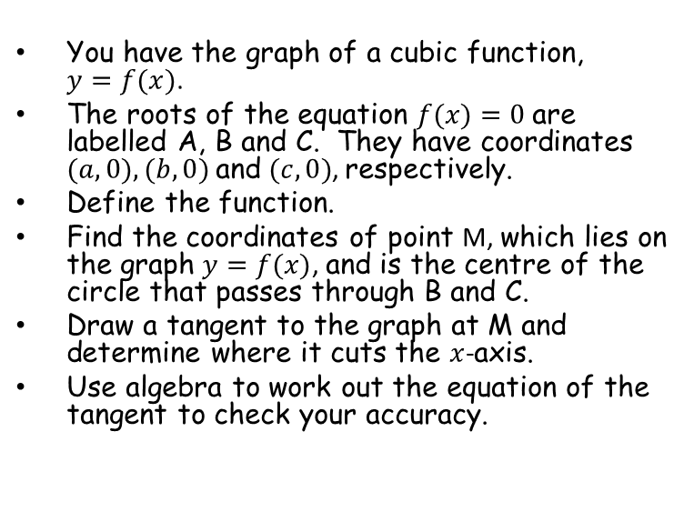
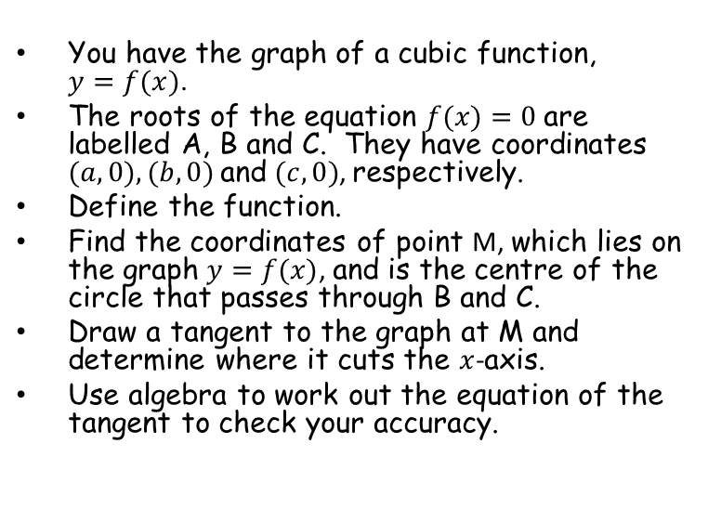
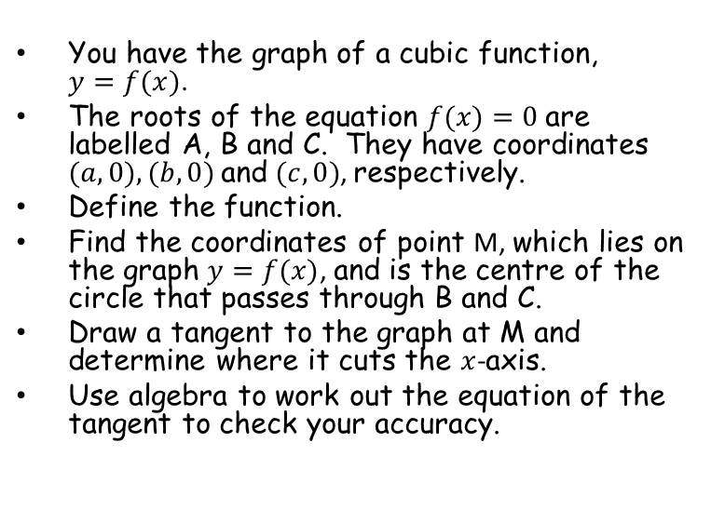
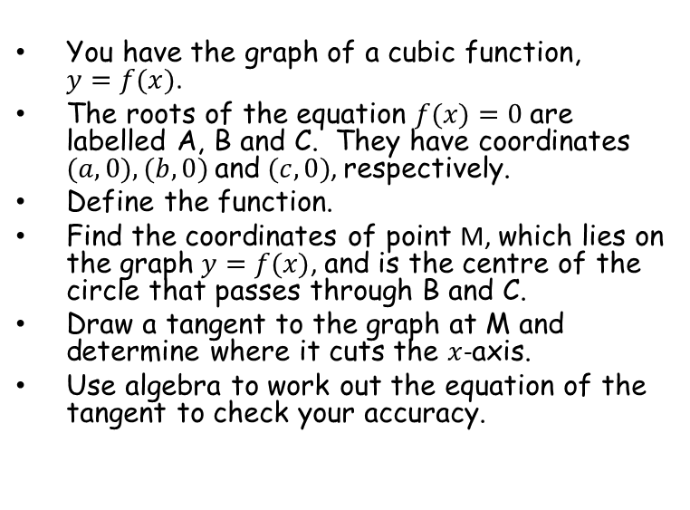
You have the graph of a cubic function, $y=f(x)$.
The roots of the equation $f(x)=0$are labelled A, B and C. They have coordinates $(a,0), (b,0)$ and $(c,0)$, respectively.
Define the function.
Find the coordinates of point M, which lies on the graph $y=f(x)$, and is the centre of the circle that passes through B and C.
Draw a tangent to the graph at M and determine where it cuts the $x$-axis.
Use algebra to work out the equation of the tangent to check your accuracy.
You have the graph of a cubic function, $y=f(x)$.
The roots of the equation $f(x)=0$are labelled A, B and C. They have coordinates $(a,0), (b,0)$ and $(c,0)$, respectively.
Define the function.
Find the coordinates of point M, which lies on the graph $y=f(x)$, and is the centre of the circle that passes through B and C.
Draw a tangent to the graph at M and determine where it cuts the $x$-axis.
Use algebra to work out the equation of the tangent to check your accuracy.
SIC_19
SIC_19
You have the graph of a cubic function, $y=f(x)$.
The roots of the equation $f(x)=0$are labelled A, B and C. They have coordinates $(a,0), (b,0)$ and $(c,0)$, respectively.
Define the function.
Find the coordinates of point M, which lies on the graph $y=f(x)$, and is the centre of the circle that passes through B and C.
Draw a tangent to the graph at M and determine where it cuts the $x$-axis.
Use algebra to work out the equation of the tangent to check your accuracy.
You have the graph of a cubic function, $y=f(x)$.
The roots of the equation $f(x)=0$are labelled A, B and C. They have coordinates $(a,0), (b,0)$ and $(c,0)$, respectively.
Define the function.
Find the coordinates of point M, which lies on the graph $y=f(x)$, and is the centre of the circle that passes through B and C.
Draw a tangent to the graph at M and determine where it cuts the $x$-axis.
Use algebra to work out the equation of the tangent to check your accuracy.
SIC_19
SIC_19
Notes:
instructions

Slide 12
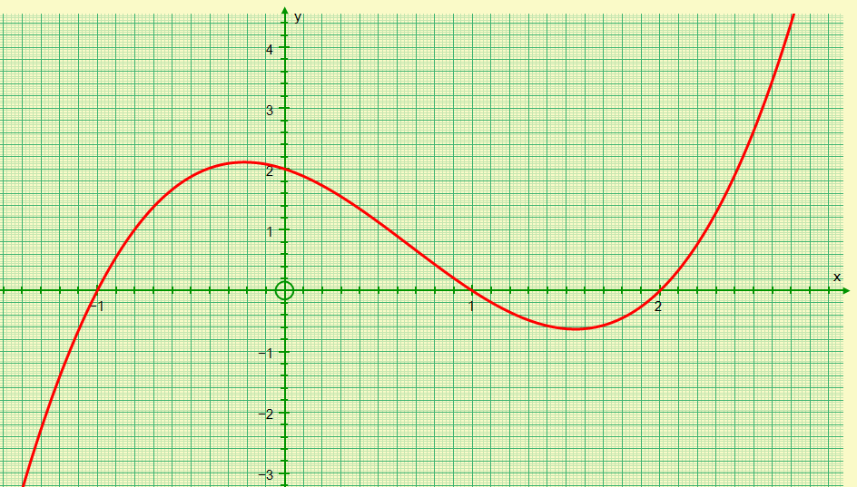
A
B
C
A
SIC_19

Slide 13
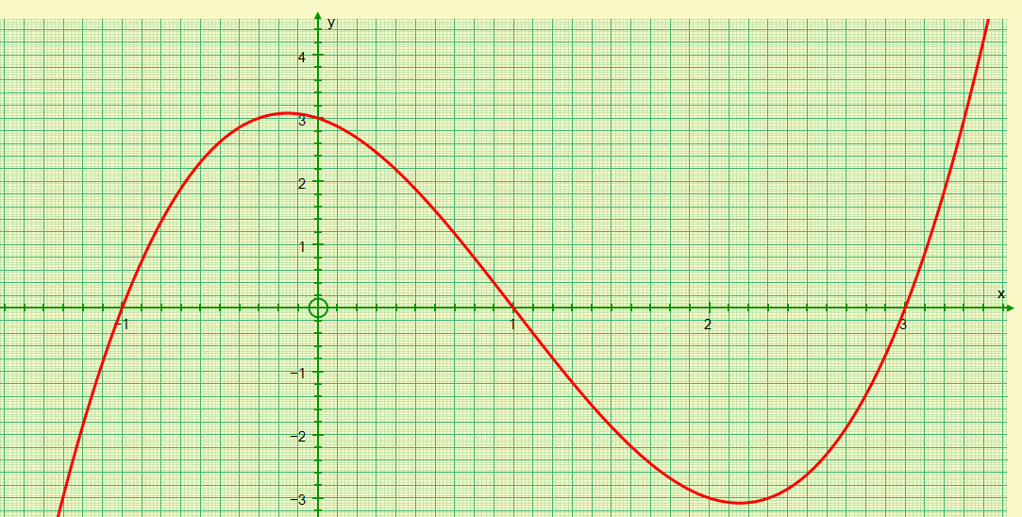
A
B
C
B
SIC_19

Slide 14
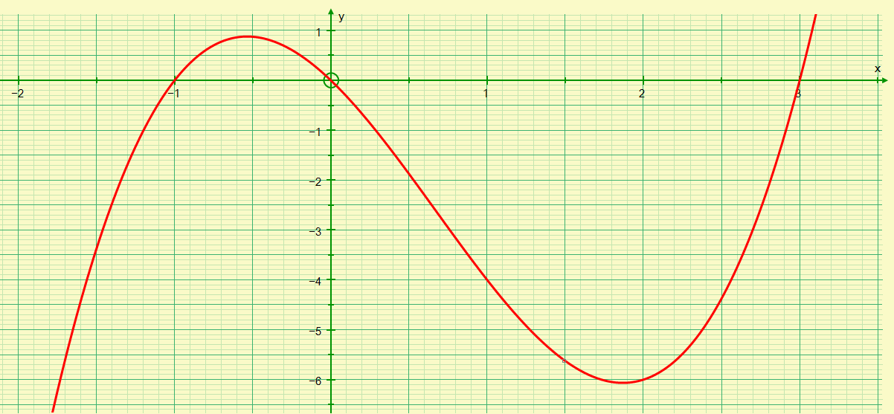
A
B
C
C
SIC_19

Slide 15
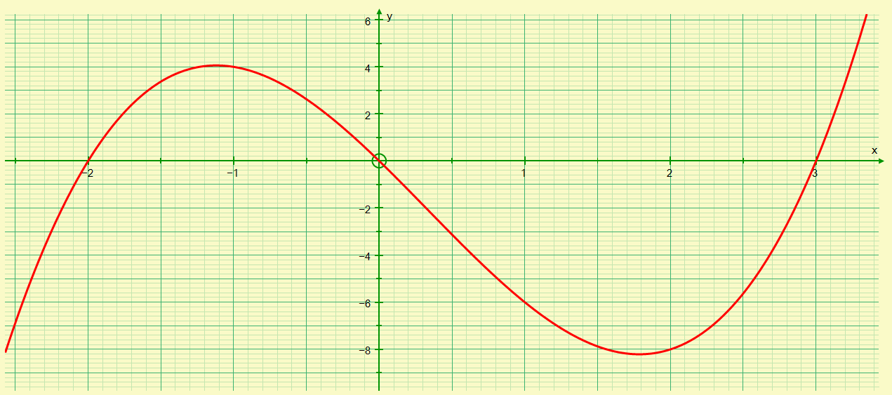
A
B
C
D
SIC_19

Slide 16
You have the graph of a cubic function, $y=f(x)$.
The roots of the equation $f(x)=0$are labelled A, B and C. They have coordinates $(a,0), (b,0)$ and $(c,0)$, respectively.
Define the function.
Find the coordinates of point M, which lies on the graph $y=f(x)$, and is the centre of the circle that passes through B and C.
Draw a tangent to the graph at M and determine where it cuts the $x$-axis.
Use algebra to work out the equation of the tangent to check your accuracy.
You have the graph of a cubic function, $y=f(x)$.
The roots of the equation $f(x)=0$are labelled A, B and C. They have coordinates $(a,0), (b,0)$ and $(c,0)$, respectively.
Define the function.
Find the coordinates of point M, which lies on the graph $y=f(x)$, and is the centre of the circle that passes through B and C.
Draw a tangent to the graph at M and determine where it cuts the $x$-axis.
Use algebra to work out the equation of the tangent to check your accuracy.
SIC_19
SIC_19
You have the graph of a cubic function, $y=f(x)$.
The roots of the equation $f(x)=0$are labelled A, B and C. They have coordinates $(a,0), (b,0)$ and $(c,0)$, respectively.
Define the function.
Find the coordinates of point M, which lies on the graph $y=f(x)$, and is the centre of the circle that passes through B and C.
Draw a tangent to the graph at M and determine where it cuts the $x$-axis.
Use algebra to work out the equation of the tangent to check your accuracy.
You have the graph of a cubic function, $y=f(x)$.
The roots of the equation $f(x)=0$are labelled A, B and C. They have coordinates $(a,0), (b,0)$ and $(c,0)$, respectively.
Define the function.
Find the coordinates of point M, which lies on the graph $y=f(x)$, and is the centre of the circle that passes through B and C.
Draw a tangent to the graph at M and determine where it cuts the $x$-axis.
Use algebra to work out the equation of the tangent to check your accuracy.
SIC_19
SIC_19
Notes:
instructions

Slide 17
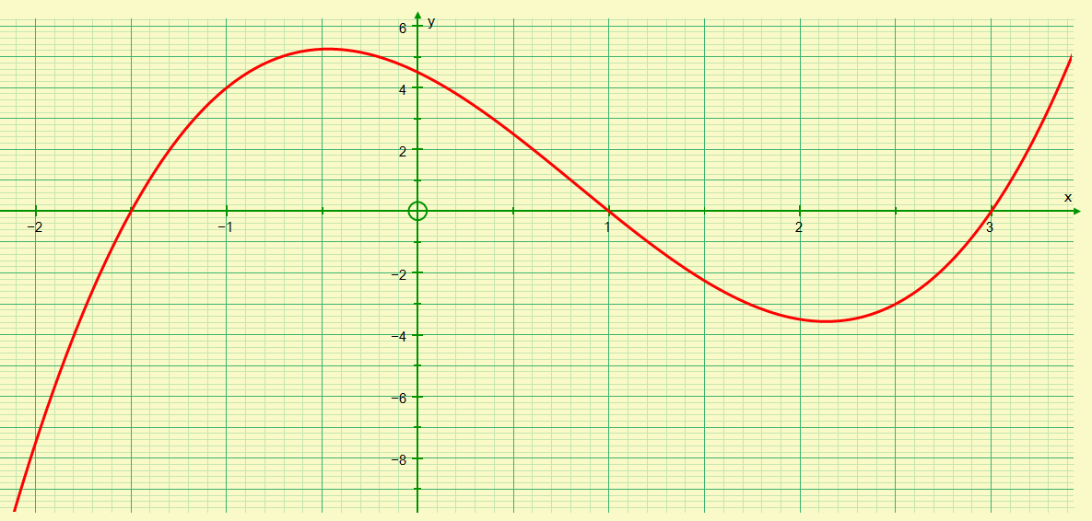
A
B
C
E
SIC_19

Slide 18
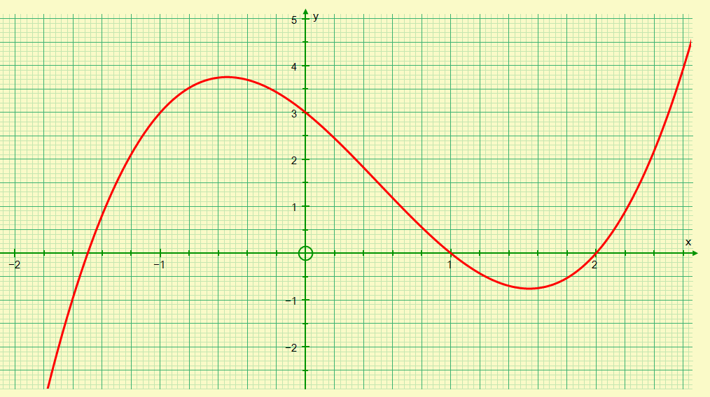
A
B
C
F
SIC_19

Slide 19
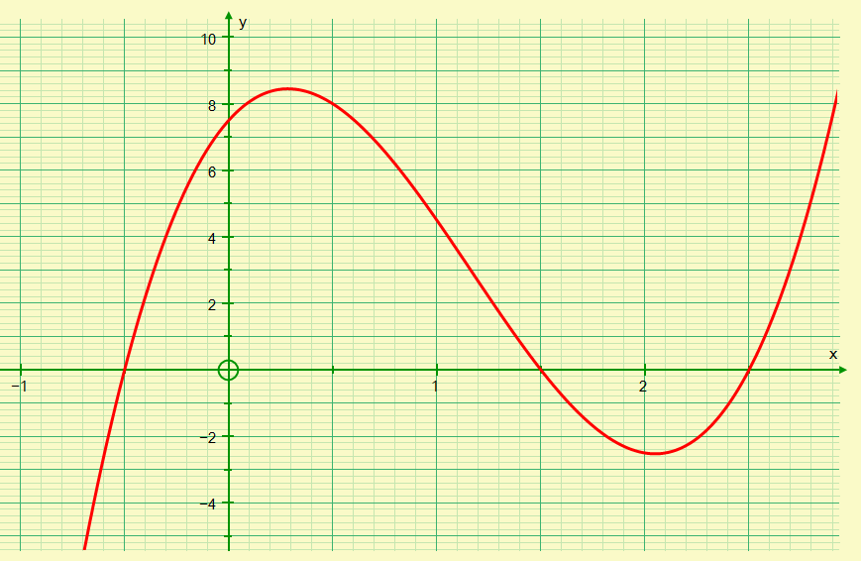
A
B
C
G
SIC_19

Slide 20
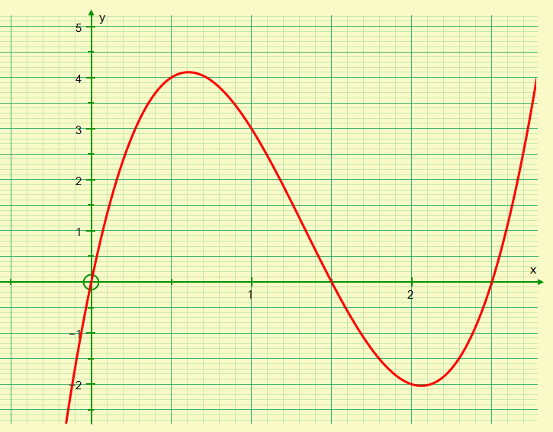
A
B
C
H
SIC_19

Slide 21
You have the graph of a cubic function, $y=f(x)$.
The roots of the equation $f(x)=0$are labelled A, B and C. They have coordinates $(a,0), (b,0)$ and $(c,0)$, respectively.
Define the function.
Find the coordinates of point M, which lies on the graph $y=f(x)$, and is the centre of the circle that passes through B and C.
Draw a tangent to the graph at M and determine where it cuts the $x$-axis.
Use algebra to work out the equation of the tangent to check your accuracy.
You have the graph of a cubic function, $y=f(x)$.
The roots of the equation $f(x)=0$are labelled A, B and C. They have coordinates $(a,0), (b,0)$ and $(c,0)$, respectively.
Define the function.
Find the coordinates of point M, which lies on the graph $y=f(x)$, and is the centre of the circle that passes through B and C.
Draw a tangent to the graph at M and determine where it cuts the $x$-axis.
Use algebra to work out the equation of the tangent to check your accuracy.
SIC_19
SIC_19
You have the graph of a cubic function, $y=f(x)$.
The roots of the equation $f(x)=0$are labelled A, B and C. They have coordinates $(a,0), (b,0)$ and $(c,0)$, respectively.
Define the function.
Find the coordinates of point M, which lies on the graph $y=f(x)$, and is the centre of the circle that passes through B and C.
Draw a tangent to the graph at M and determine where it cuts the $x$-axis.
Use algebra to work out the equation of the tangent to check your accuracy.
You have the graph of a cubic function, $y=f(x)$.
The roots of the equation $f(x)=0$are labelled A, B and C. They have coordinates $(a,0), (b,0)$ and $(c,0)$, respectively.
Define the function.
Find the coordinates of point M, which lies on the graph $y=f(x)$, and is the centre of the circle that passes through B and C.
Draw a tangent to the graph at M and determine where it cuts the $x$-axis.
Use algebra to work out the equation of the tangent to check your accuracy.
SIC_19
SIC_19
Notes:
instructions

Slide 22
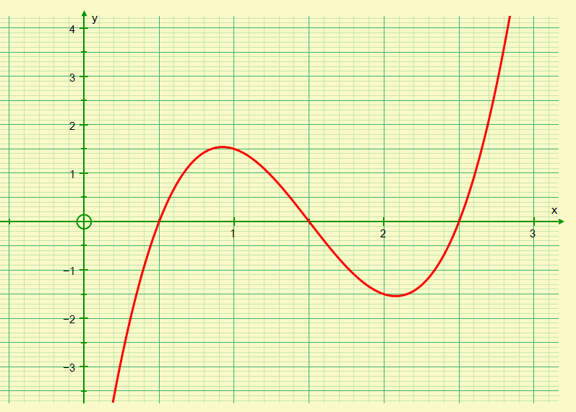
A
B
C
I
SIC_19

Slide 23
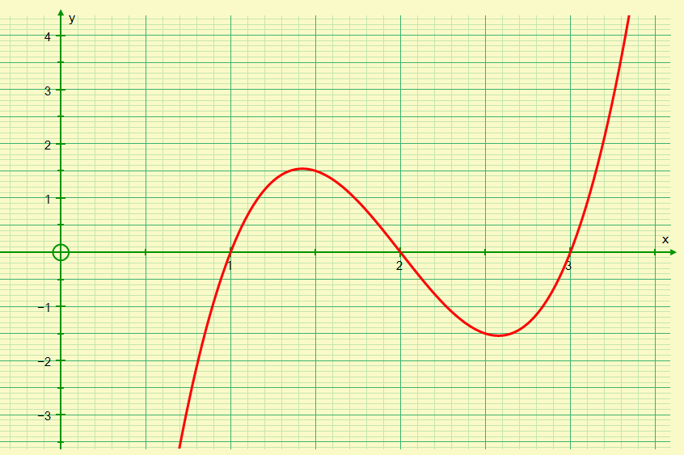
A
B
C
J
SIC_19

Slide 24
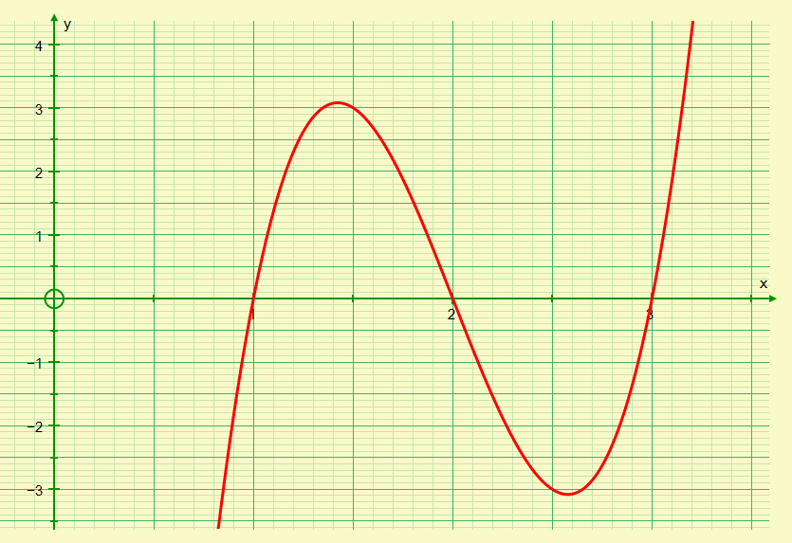
A
B
C
K
SIC_19

Slide 25
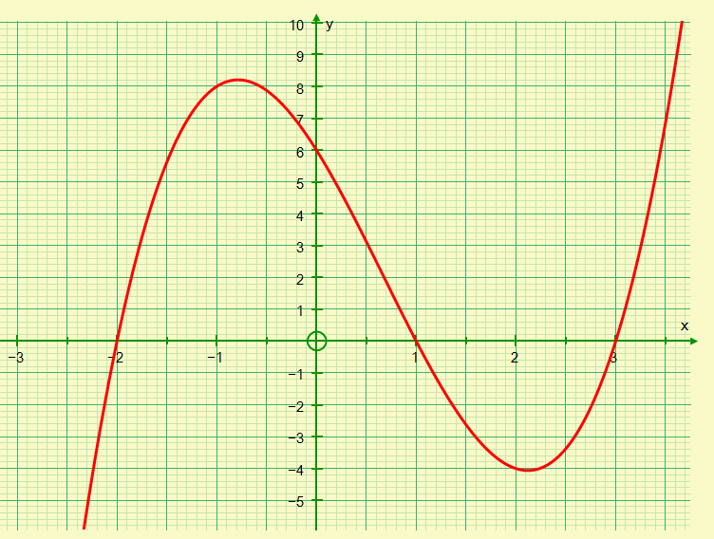
A
B
C
L
SIC_19

